Slide 1
IT161 LAB 1 Name : Snehal Nalawade Student ID : 202151160 Date : 07/01/2022
Topic : Ramesh’s basic salary is input through the keyboard. His dearness allowance is 40% of the basic salary and house rent allowance is 20% of basic salary. Write an algorithm, flowchart and program to calculate his gross salary.
Objective : To write a C program to input basic salary from the user and display the gross salary on the screen.

Slide 2
Algorithm of the program :
Step 1 : Start
Step 2 : declare and initialize float type variables BS, DA, HRA and GS
Step 3 : take basic salary (BS) as input from the user
Step 4 : calculate the dearness allowance (DA) and house rent allowance (HRA)
Step 5 : BS + DA + HRA gross salary (GS)
Step 6 : display the gross salary (GS)
Step 7 : Stop

Slide 3
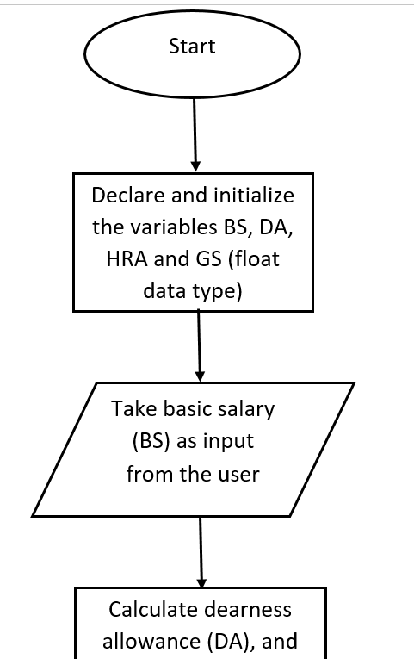
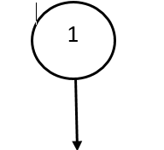
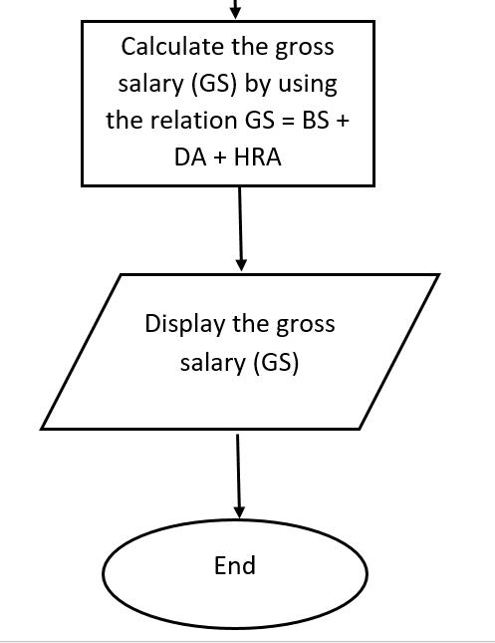
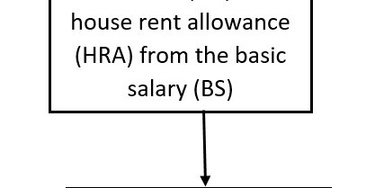

Flowchart of the program :

Slide 4
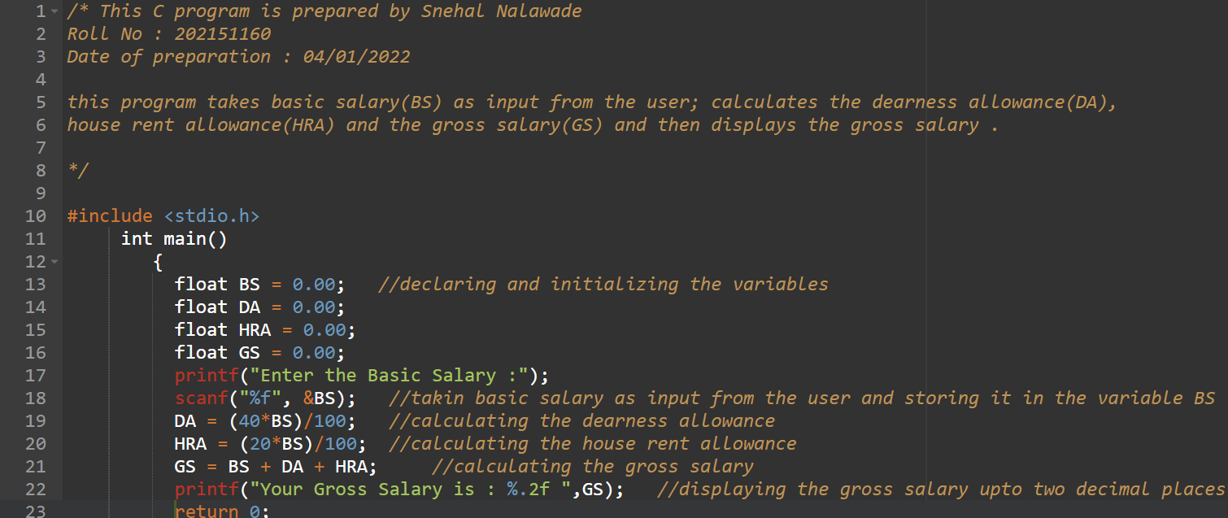
Source code of the C program :

Slide 5
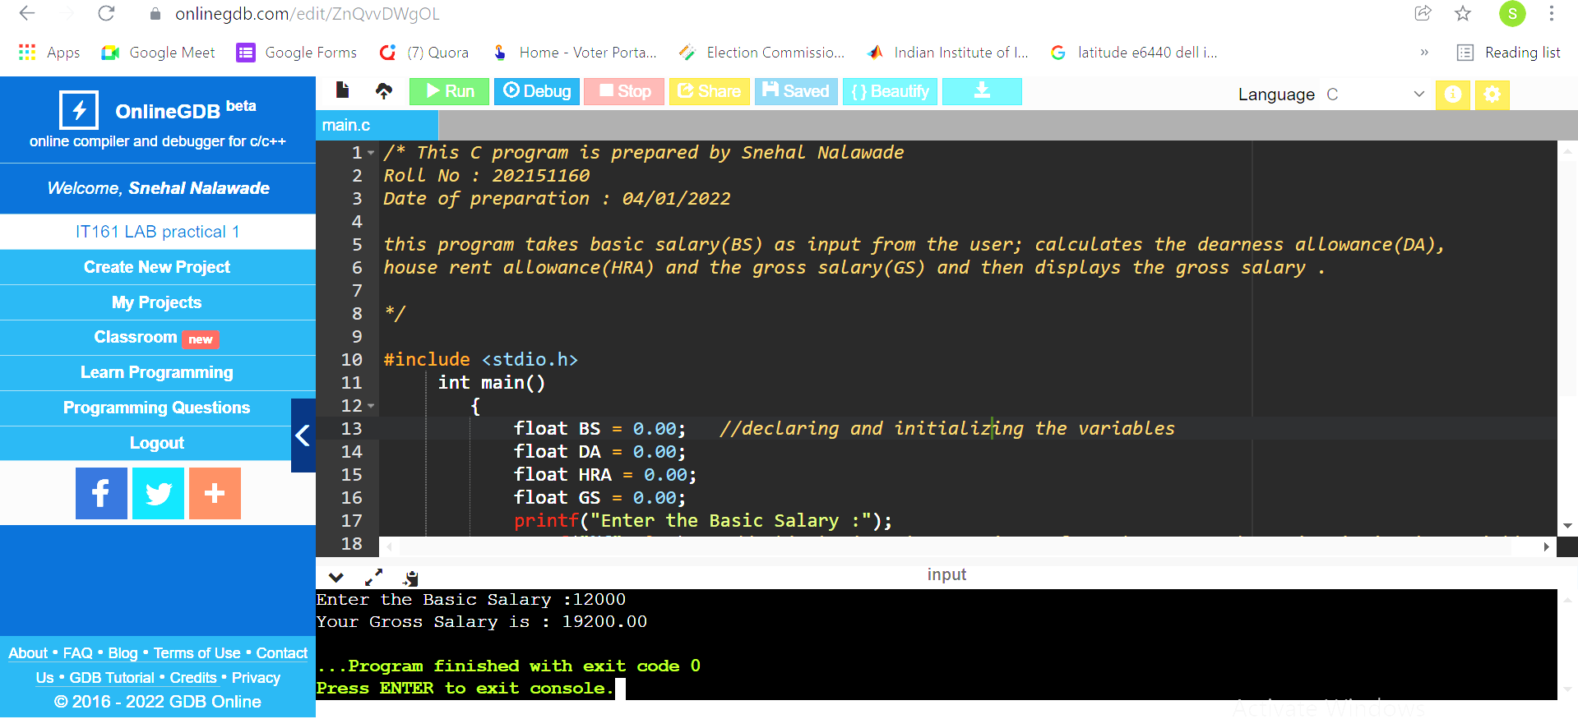
Outputs after executing the C program :
1)

Slide 6
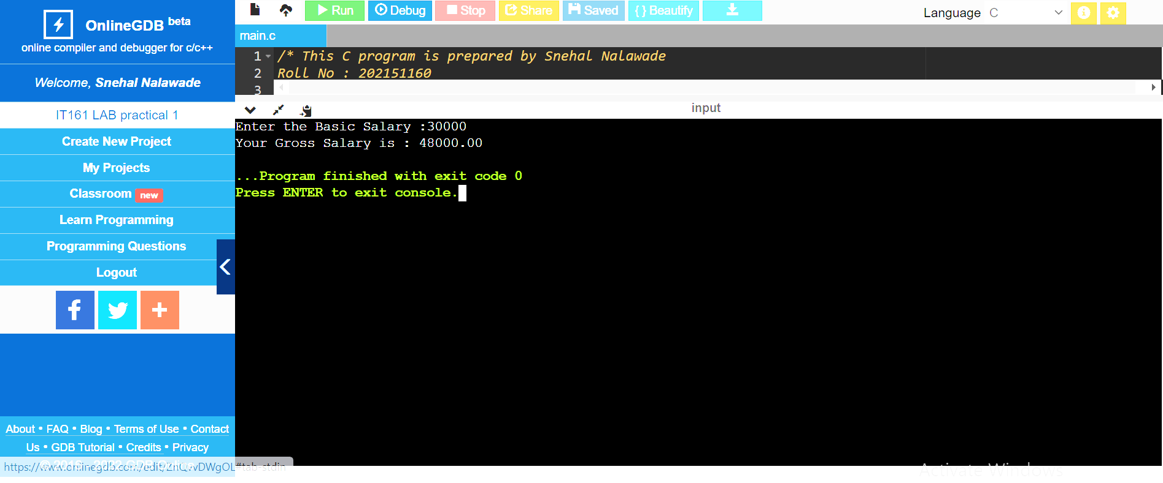
2)

Slide 7
Thank You

